Slide 1
Chapter 11
Message Integrity
and
Message Authentication
11.<number>

Slide 2
Chapter 11
Objectives
❏ To define message integrity
❏ To define message authentication
❏ To define criteria for a cryptographic hash function
❏ To define the Random Oracle Model and its role in
evaluating the security of cryptographic hash
functions
❏ To distinguish between an MDC and a MAC
❏ To discuss some common MACs
11.<number>

Slide 3
11-1 MESSAGE INTEGRITY
The cryptography systems that we have studied so far provide secrecy, or confidentiality, but not integrity.
However, there are occasions where we may not even need secrecy but instead must have integrity.
Topics discussed in this section:
11.1 Document and Fingerprint
11.2 Message and Message Digest
11.3 Difference
11.4 Checking Integrity
11.5 Cryptographic Hash Function Criteria
11.<number>

Slide 4
11.1.1 Document and Fingerprint
One way to preserve the integrity of a document is through the use of a fingerprint.
If Alice needs to be sure that the contents of her document will not be changed, she can put her fingerprint at the bottom of the document.
11.<number>

Slide 5
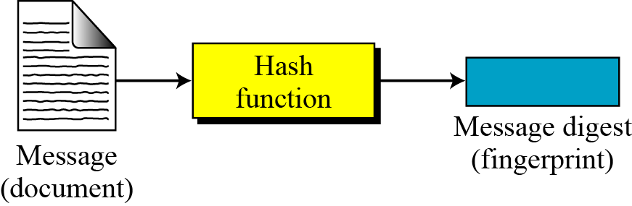
11.1.2 Message and Message Digest
The electronic equivalent of the document and fingerprint pair is the message and digest pair.
Figure 11.1 Message and digest
11.<number>

Slide 6

11.1.3 Difference
The two pairs (document / fingerprint) and (message / message digest) are similar, with some differences.
The document and fingerprint are physically linked together.
The message and message digest can be unlinked separately, and, most importantly, the message digest needs to be safe from change.
Note
The message digest needs to be safe from change.
11.<number>

Slide 7
hash function
A hash function accepts
a variable size message M , as input
and produces a fixed-size output
referred to as a hash code h(M) or message Digest or hash value.
-it does not use a key.
-it is only a function of input message.
- assumed to be public
A change to any bit or bits in the message, results in a change to the hash code.
y = h(M)
11.<number>

Slide 8
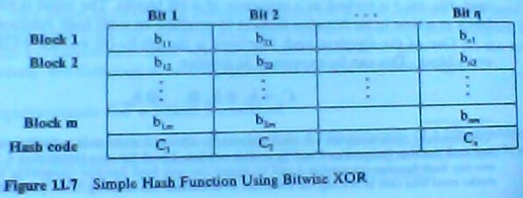
Simple Hash Functions
are several proposals for simple functions
based on XOR of message blocks
11.<number>

Slide 9
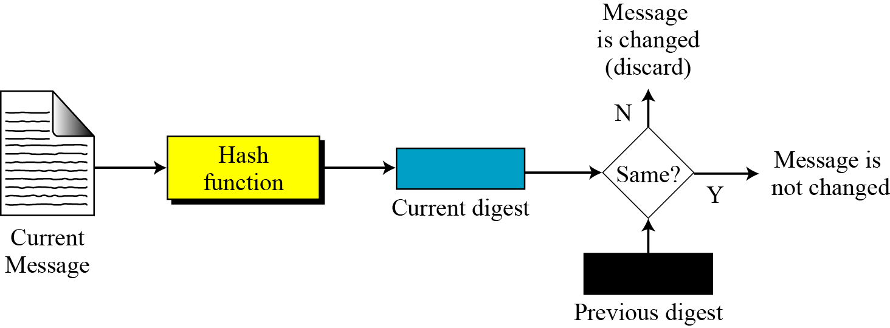
11.1.4 Checking Integrity
Figure 11.2 Checking integrity
11.<number>

Slide 10
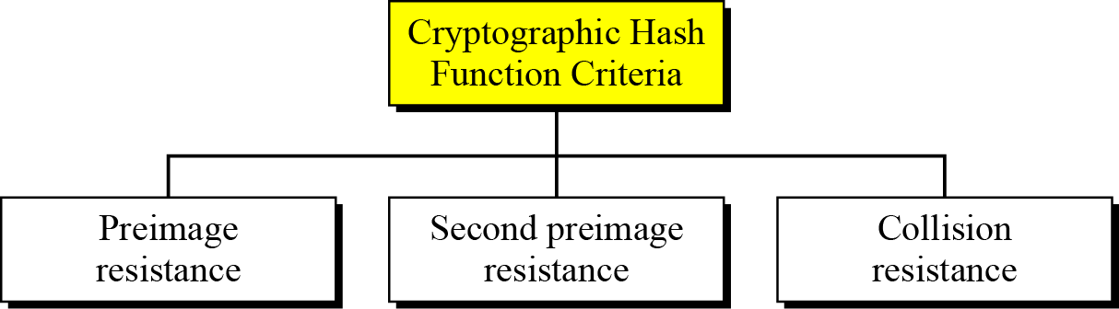
11.1.5 Cryptographic Hash Function Criteria
A cryptographic hash function must satisfy three criteria: preimage resistance,
second preimage resistance,
and collision resistance.
Figure 11.3 Criteria of a cryptographic hash function
11.<number>

Slide 11
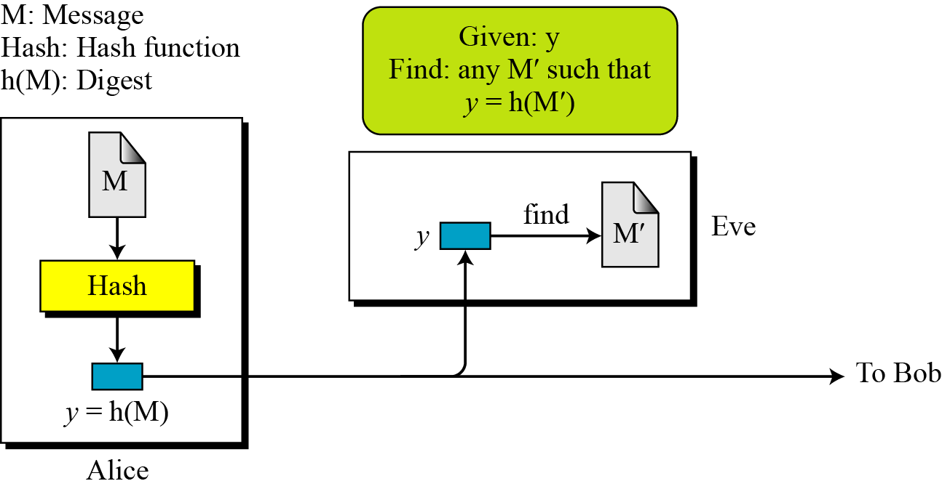
11.1.5 Continued
Preimage Resistance
11.<number>

Slide 12
11.1.5 Continued
Example 11.1
Can we use a conventional lossless compression method such as StuffIt as a cryptographic hash function?
Solution
We cannot. A lossless compression method creates a compressed message that is reversible.
Example 11.2
Can we use a checksum function as a cryptographic hash function?
Solution
We cannot. A checksum function is not preimage resistant, Eve may find several messages whose checksum matches the given one.
11.<number>

Slide 13
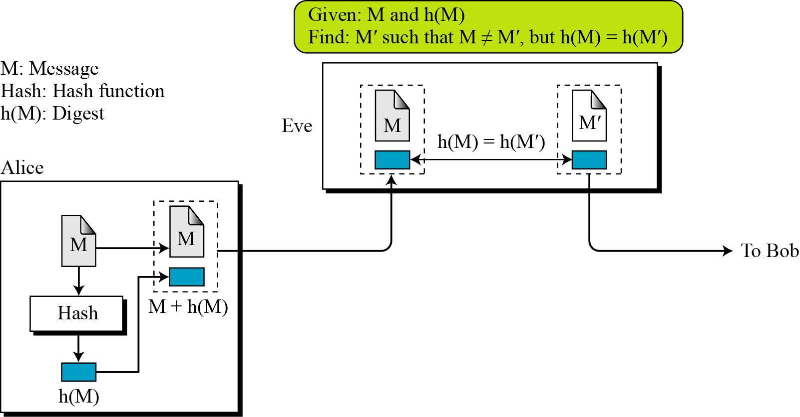
11.1.5
Ensures that a message can not easily be forged
Second Preimage Resistance
11.<number>
Figure 11.5 Second preimage

Slide 14
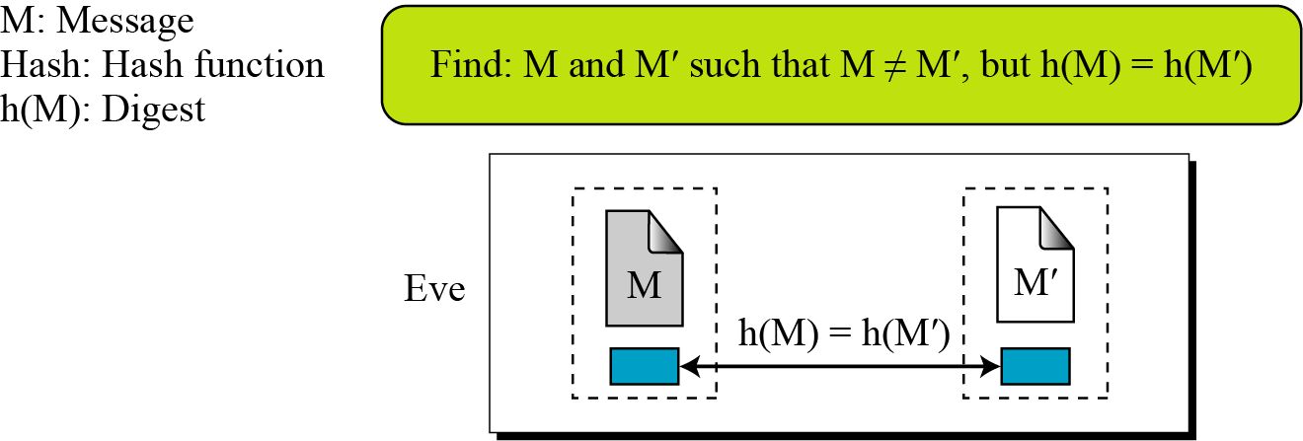
11.1.5 Continued
Collision Resistance
Figure 11.6 Collision
11.<number>

Slide 15
11-2 RANDOM ORACLE MODEL
The Random Oracle Model, which was introduced in 1993 by Bellare and Rogaway, is an ideal mathematical model for a hash function.
A random oracle is a mathematical function mapping every possible query to a random response from its output domain.
Topics discussed in this section:
11.2.1 Pigeonhole Principle
11.2.2 Birthday Problems
11.2.3 Attacks on Random Oracle Model
11.2.4 Attacks on the Structure
11.<number>

Slide 16
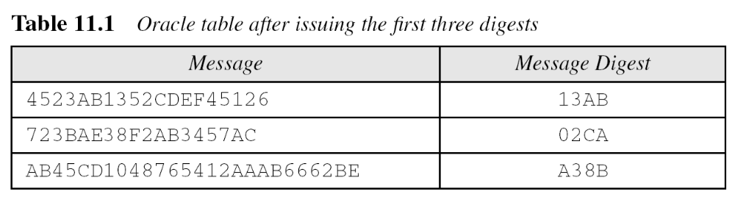
11-2 Continued
Example 11.3
Assume an oracle with a table. The table has two columns.
The message AB1234CD8765BDAD is given for digest calculation. The oracle checks its table. The oracle flips the coin16 times. And the result is HHTH… = 1101…
Where Head H=1 and Tail T=0
11.<number>

Slide 17
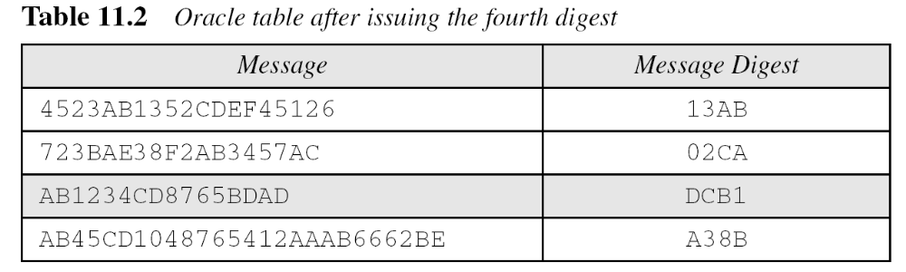
11-2 Continued
Example 11.3
Continued
b. The message 4523AB1352CDEF45126 is given for digest calculation. The oracle checks its table and finds that there is a digest for this message in the table (first row). The oracle simply gives the corresponding digest (13AB).
11.<number>

Slide 18
11-2 Continued
Example 11.4
The oracle in Example 11.3 cannot use a formula or algorithm to create the digest for a message. For example, imagine the oracle uses the formula h(M) = M mod n. Now suppose that the oracle has already given h(M1) and h(M2). If a new message is presented as M3 = M1 + M2, the oracle does not have to calculate the h(M3). The new digest is just [h(M1) + h(M2)] mod n since
This violates the third requirement that each digest must be randomly chosen based on the message given to the oracle.
11.<number>

Slide 19
11.2.1 Pigeonhole Principle
If n pigeonholes are occupied by n + 1 pigeons, then at least one pigeonhole is occupied by two pigeons. The generalized version of the pigeonhole principle is that if n pigeonholes are occupied by kn + 1 pigeons, then at least one pigeonhole is occupied by k + 1 pigeons.
11.<number>

Slide 20
birthday problem
What is the minimum value of k such that the probability is >= 0.5 that at least 2 people in a group of k people have the same birthday ?
i.e. find the smallest value of k
s.t. P(365,k)>=0.5
Solution:
K = = 1.18
for n = 365
K= 1.18 x √365 = 22.54 ≈ 23
11.<number>

Slide 21
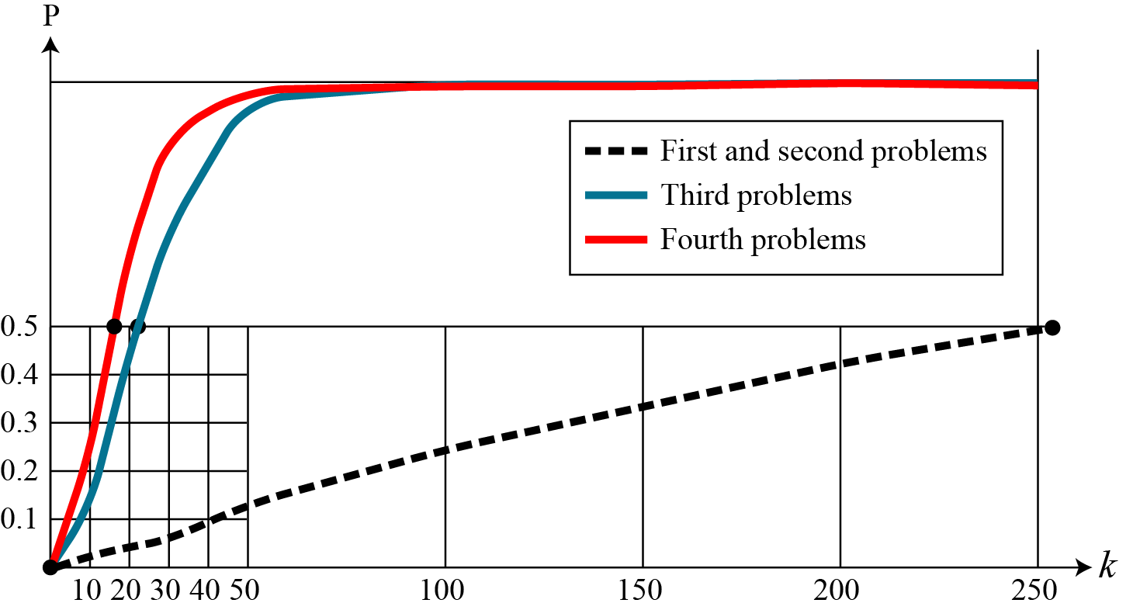
11.2.2 Continued
Comparison
Figure 11.8 Graph of four birthday problem
11.<number>

Slide 22
11.2.3 Continued
Example 11.6
A cryptographic hash function uses a digest of 64 bits. How many digests does Eve need to create to find the original message with the probability more than 0.5?
Solution
The number of digests to be created is k ≈ 0.69 × 2^{n} ≈ 0.69 × 2⁶⁴. This is a large number. Even if Eve can create 2³⁰ (almost one billion) messages per second, it takes 0.69 × 2³⁴ seconds or more than 500 years. This means that a message digest of size 64 bits is secure with respect to preimage attack, but, as we will see shortly, is not secured to collision attack.
11.<number>

Slide 23
11.2.3 Continued
Example 11.7
A cryptographic hash function uses a digest of 64 bits. How many digests does Eve need to create to find two messages with the same digest with the probability more than 0.5?
Solution
The number of digests to be created is k ≈ 1.18 × 2^{n/2} ≈ 1.18 × 232. If Eve can test 2²⁰ (almost one million) messages per second, it takes 1.18 × 2¹² seconds, or less than two hours. This means that a message digest of size 64 bits is not secure against the collision attack.
11.<number>

Slide 24
11-3 MESSAGE AUTHENTICATION
A message digest does not authenticate the sender of the message. To provide message authentication, Alice needs to provide proof that it is Alice sending the message and not an impostor.
The digest created by a cryptographic hash function is normally called a modification detection code (MDC).
What we need for message authentication is a message authentication code (MAC).
11.<number>

Slide 25
11.3.1 Modification Detection Code (MDC)
A modification detection code (MDC) is a message digest that can prove the integrity of the message: that message has not been changed.
If Alice needs to send a message to Bob and be sure that the message will not change during transmission, Alice can create a message digest, MDC, and send both the message and the MDC to Bob.
Bob can create a new MDC from the message and compare the received MDC and the new MDC. If they are the same, the message has not been changed.
11.<number>

Slide 26
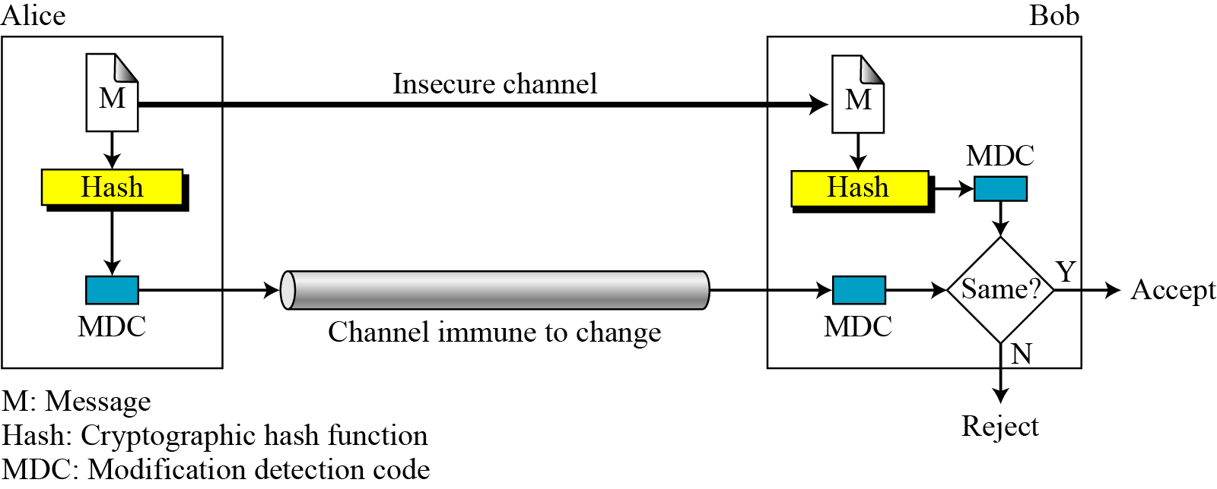
11.3.1 Continued
Figure 11.9 Modification detection code (MDC)
11.<number>

Slide 27
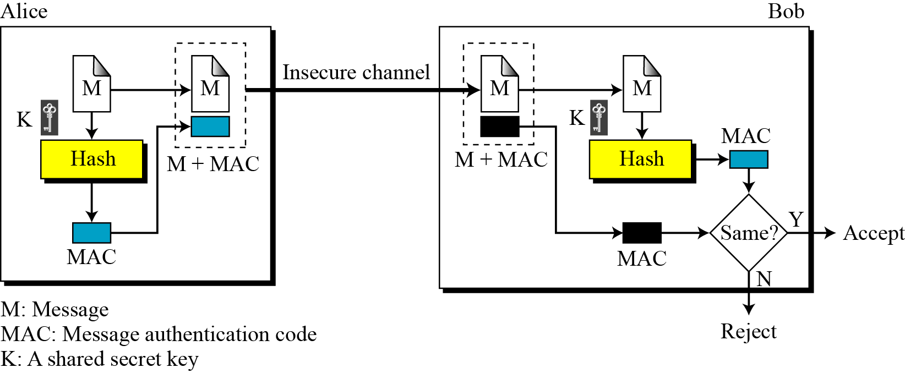
11.3.2 Message Authentication Code (MAC)
MAC includes a shared secret key.
Figure 11.10 Message authentication code
11.<number>

Slide 28
11.3.2 Continued
Note
The security of a MAC depends on the security of the underlying hash algorithm.
11.<number>

Slide 29
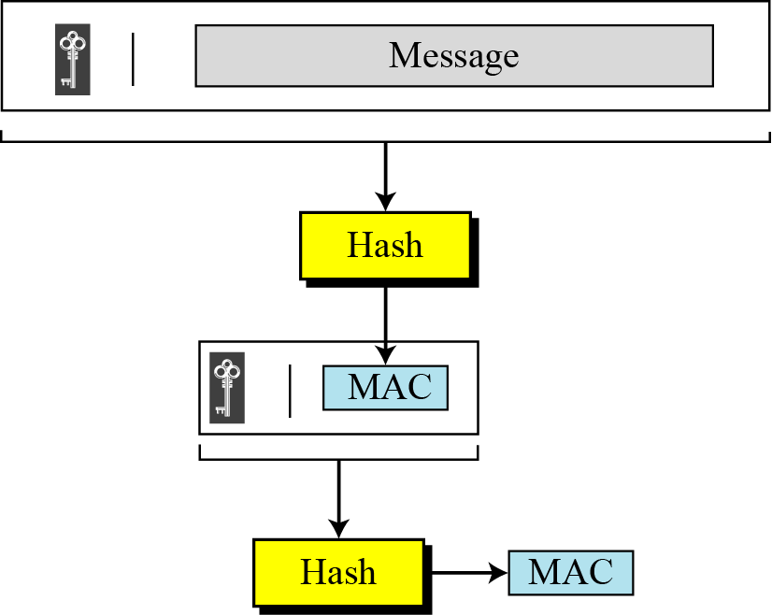
11.3.2 Continued
Nested MAC
Figure 11.11 Nested MAC
11.<number>

Slide 30
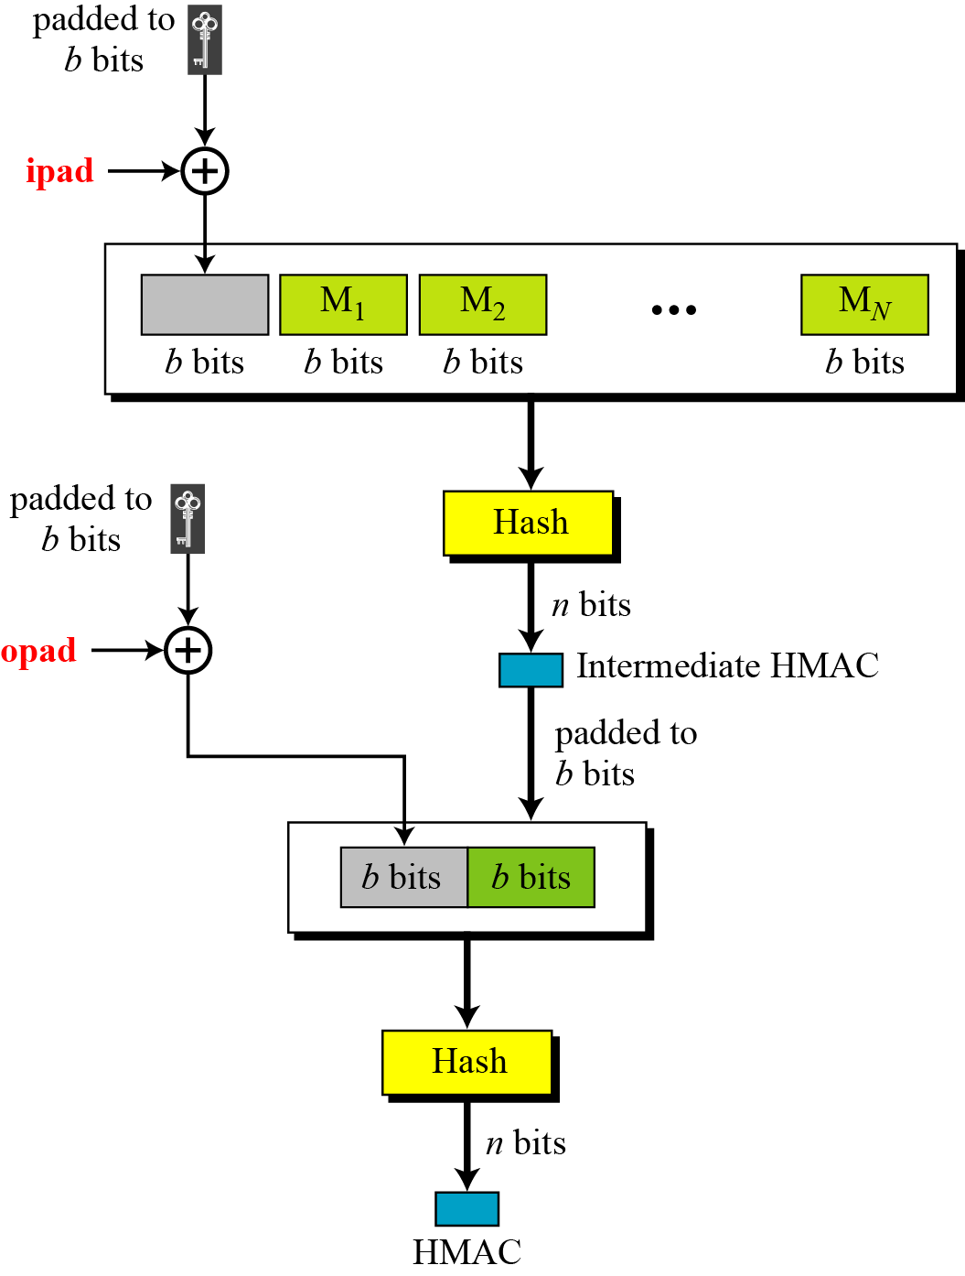
HMAC
Figure 11.12
Details of
Hashed MAC
Keyed Hash Message Authentication Code
11.<number>

Slide 31
HMAC uses the following parameters:
B Block size (in bytes) of the input to the Approved hash function.
H An Approved hash function.
ipad Inner pad; the byte x ’36’ repeated B times.
K Secret key shared between the originator and the intended receiver(s).
L Block size (in bytes) of the output of the Approved hash function.
opad Outer pad; the byte x’5c’ repeated B times.
t The number of bytes of MAC.
|| Concatenation
Å Exclusive-Or operation
11.<number>

Slide 32
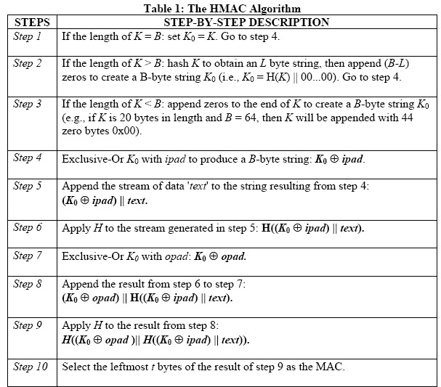
11.<number>

Slide 33
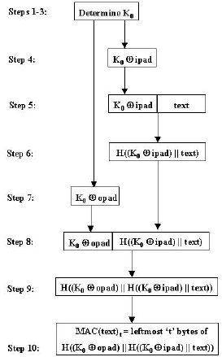
11.<number>

Slide 34
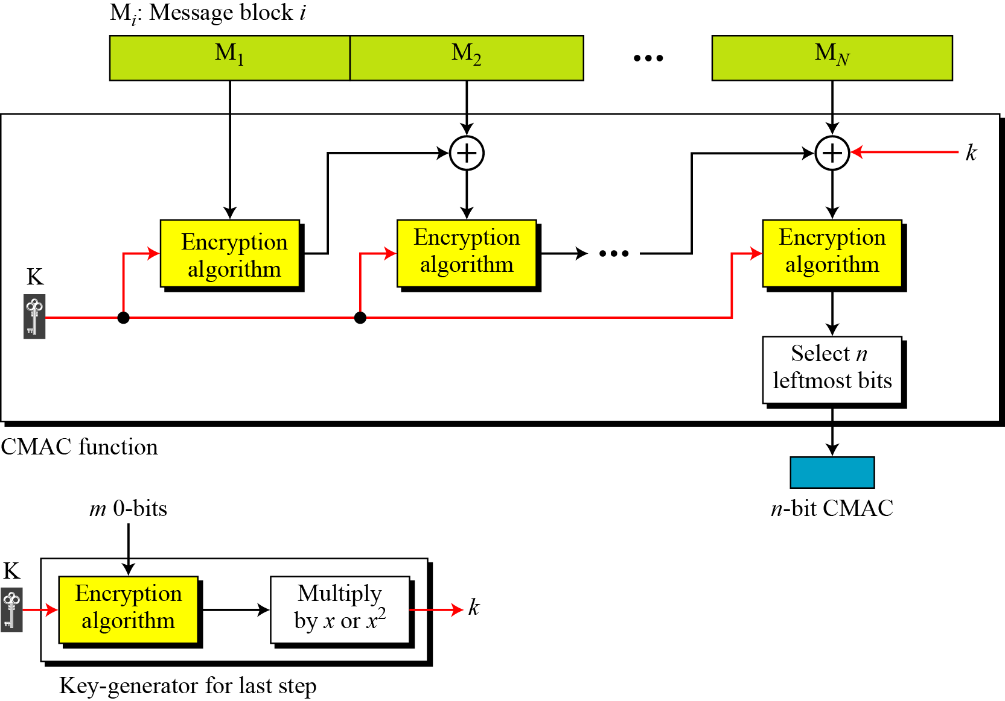
11.3.2 CMAC or CBCMAC
Figure 11.13 CMAC
11.<number>

